Slide 1
COMPUTATIONAL CREATIVITY
Aakanksha N S
B130203CS

Slide 2
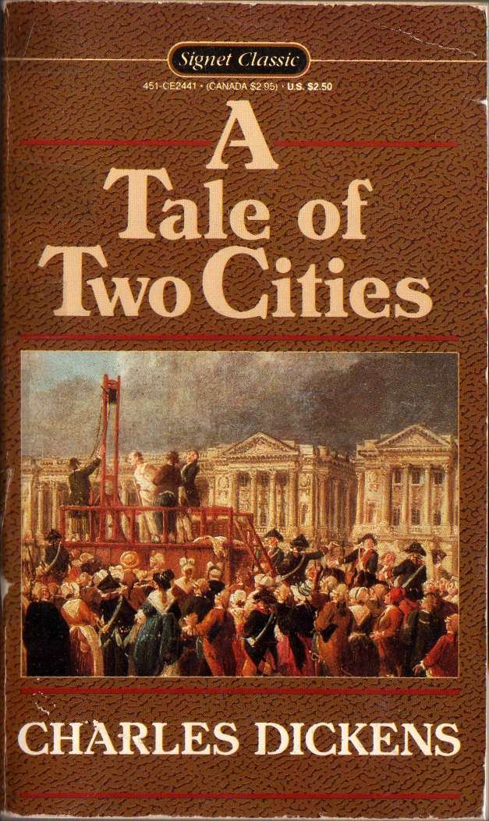
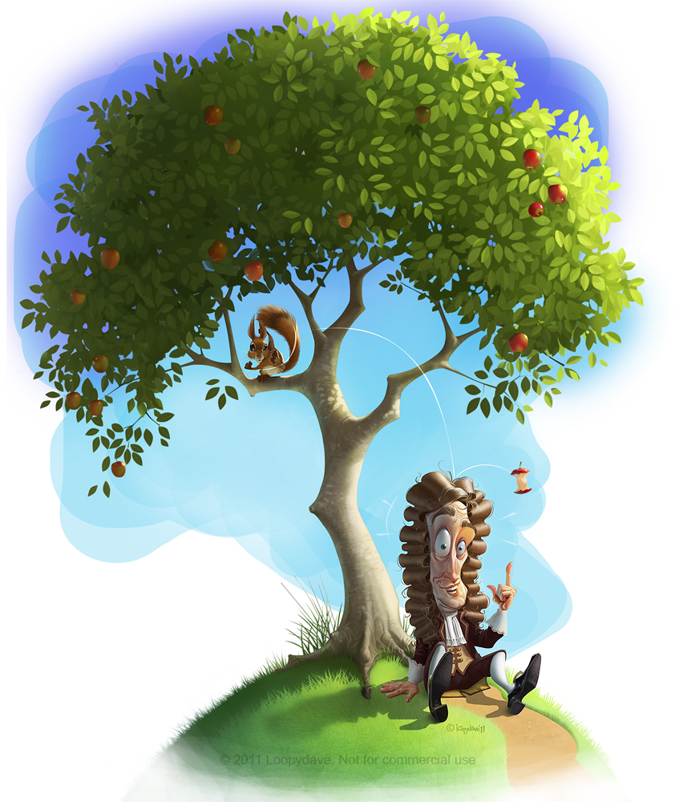
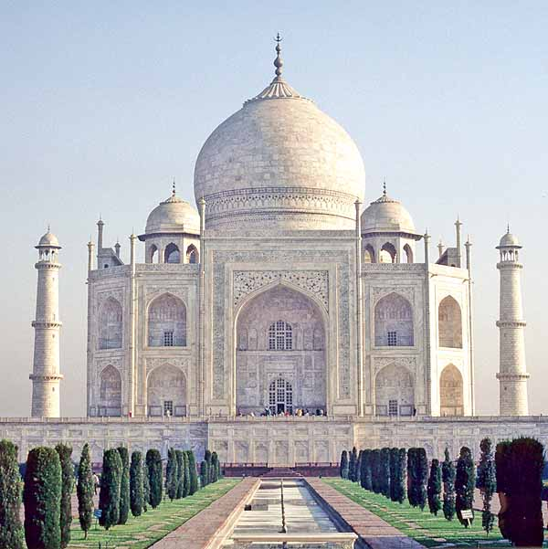


What is Creativity?
The ability to generate novel, and valuable, ideas . These ideas can be:
Interesting
Useful
Beautiful
Simple
Richly Complex

Slide 3

Can Computers be Creative?

Slide 4
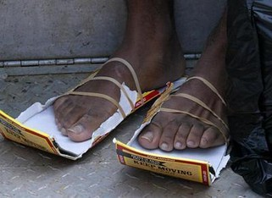
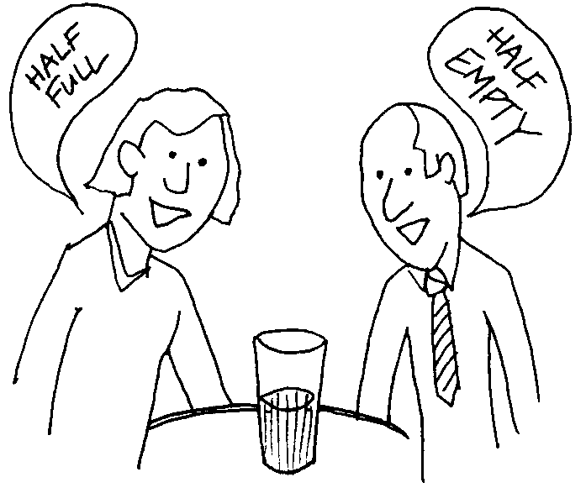
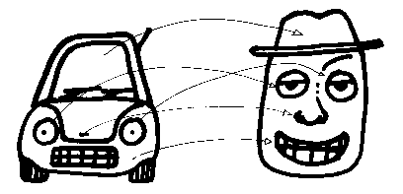
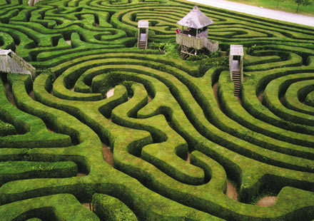

Creativity is a feature of human intelligence in general. Neurocognitive analysis says it involves the following capacities:
Associativity of ideas
Perception
Analogical Thinking
Exploring a structured problem space
Reflective Self-criticism

Slide 5
Programming these abilities into a computer poses a serious challenge to computer scientists.
However, meticulous research has been done in several areas, and algorithms have been developed to make computers creative
We shouldn’t say that a computer has failed simply because it can’t match the heights of human intelligence.

Slide 6
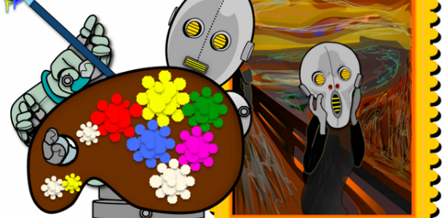
COMPUTATIONAL CREATIVITY AND ART

Slide 7



Generating Art Tile Patterns using Genetic Algorithm
Representation:
First population:
uniformly selected in the range of 0 to 255.
Replication and Mutation:
100 replications, using following possible mutations:
- Swapping the value of two random points
- Copying the value of a random point to another random point
- Assigning a random value to a random point
Chromosome
Whole tile

Slide 8
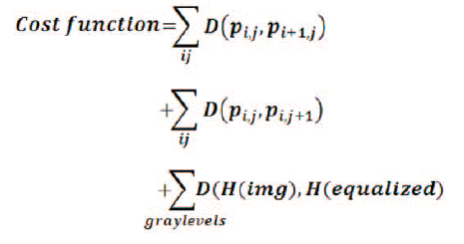
Fitness evaluation:
Cost function used to find cost of each offspring
Selection:
Offspring ranked according to cost, one with minimum value is taken
Termination:
Experimentally, 15000 iterations was determined as the termination
condition

Slide 9
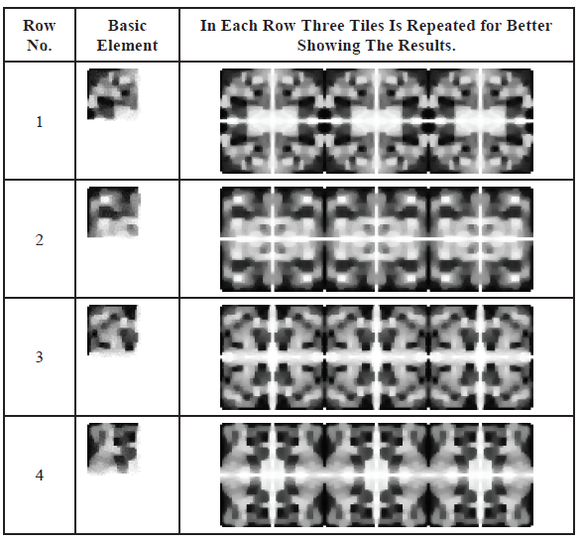
Sample results

Slide 10
Art using Convolutional Neural Networks
The class of Deep Neural Networks that are most powerful in image processing
Neural networks consist of layers of small computational units that process visual information hierarchically in a feed-forward
manner.
In this algorithm:
Each layer of units extracts a certain feature of the image.
Style and content of a picture are separated
Style from one picture and content from the other, used to generate a completely new picture.

Slide 11
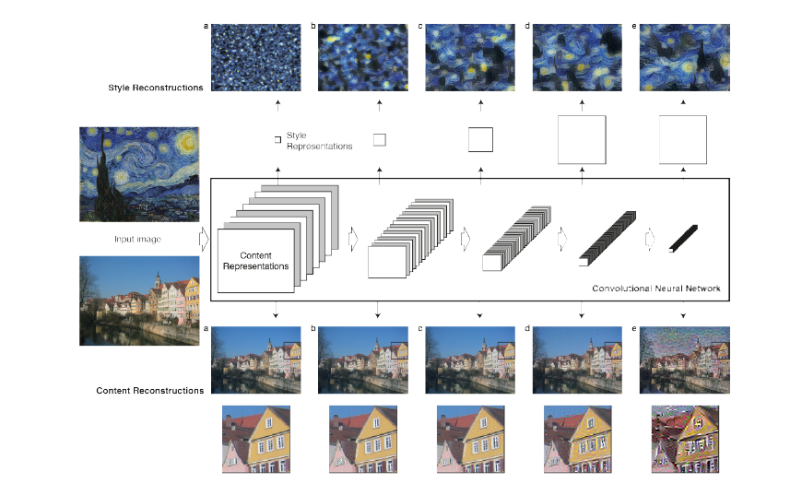

Slide 12
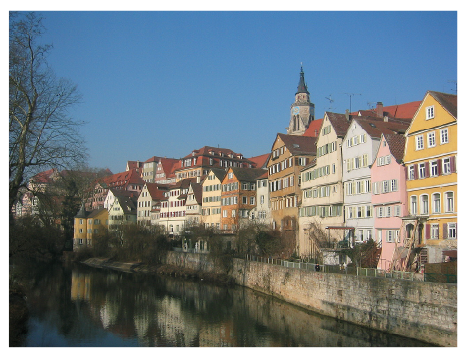
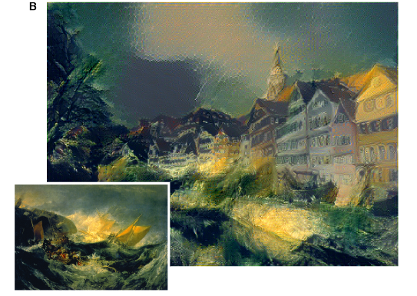
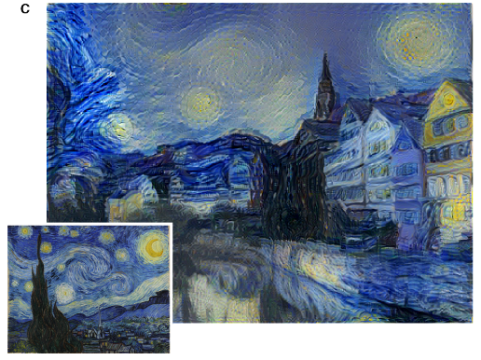
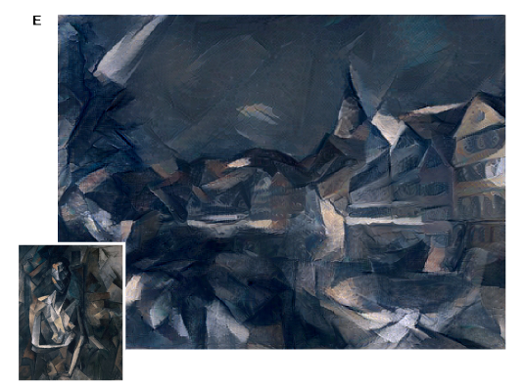
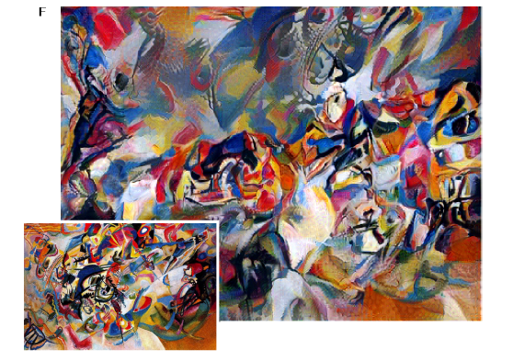
Picture used for content

Slide 13
AARON
Developed by Harold Cohen , it is “an autonomous entity capable of generating original artworks” of exceptional aesthetic value, each one unique.
has been taught how to draw basic forms and shapes that form the components of an image, and it makes decisions by considering what it wants to do in relation to what it has done already (self-feedback).
Based on a basic notions of color, it develops its own color schemes and colors the images.

Slide 14
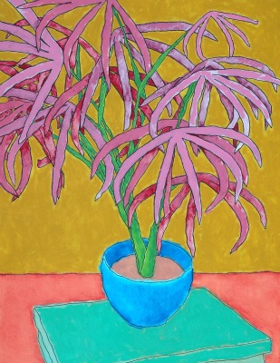
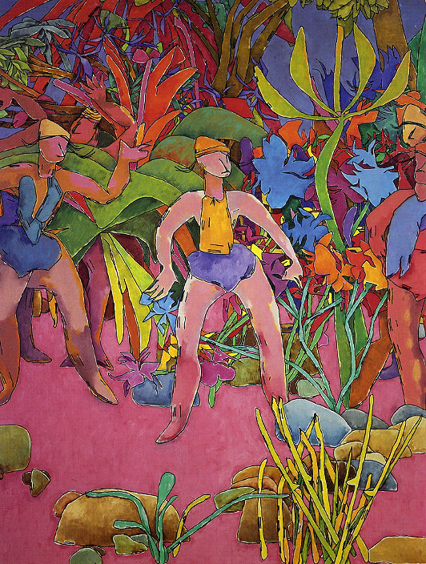
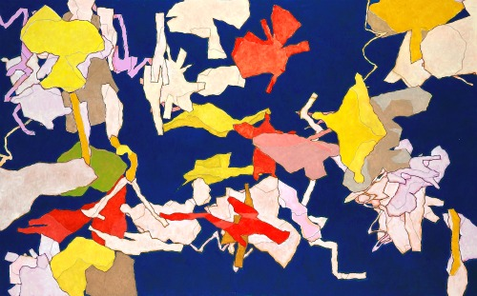
Artworks by AARON

Slide 15
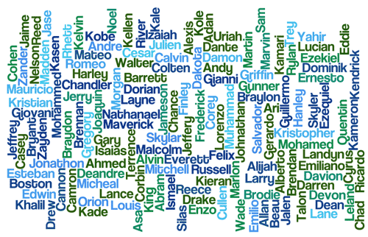
GENERATING NEW AND INTERESTIONG NAMES USING COMPUTERS

Slide 16
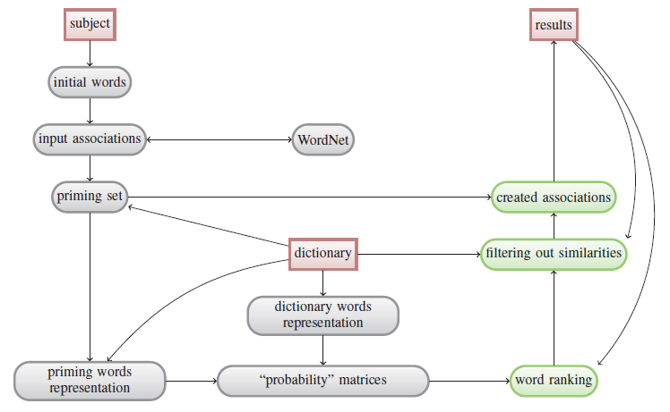
Goal: Given description of object (product,organization, service, internet site , invention) create a new name that can be easily remembered and reflects some qualities strongly associated with the object itself
Sample results: bookstion, cablects, gonewsy, infordata

Slide 17

MUSIC AND OTHER AREAS

Slide 18

EMI (Emmy)
Developed by David Cope over 2001-2006, Emmy (EMI : Experiments in Musical Intelligence) composes music in the style of composers such as Bach, Beethoven, Chopin, Mahler.
Has capability of analyzing and generalizing from existing music by a human composer to generate new musical compositions of the same style.

Slide 19
JAPE
“Joke Analysis and Production Engine”
Developed by Graeme Ritchie and Kim Binsted
Designed to generate question-answer-type puns.
Some examples of riddles created using JAPE:
Q: What do you call a strange market?
A: A bizarre bazaar.
Q: What is the difference between leaves and a car?
A: One you brush and rake, the other you rush and brake.
Q : What kind of murderer has fibre?
A : A cereal killer.

Slide 20
How JAPE Works
Confusable texts : if an utterance of a spelling is ambiguous, then it has more than one written forms.
“serial” and “cereal”
“spec” and “spook”
Juxtaposition : simply placing the confusing segments near each other.
“bizarre bazaar”
Substitution : substituting one confusable segment for another and using the resulting text.
Q : What does a near-sighted ghost wear?
A : Spooktacles
Comparison : explicitly compares two confusable text, usually by asking for similarities or differences.
Q : What’s the difference between a short witch and a deer running from the hunters?
A : One’s a stunted hag and the other is hunted stag.!!!!

Slide 21
Other areas
Computational Creativity has been applied to many other areas like:
Storytelling activities
Metaphor and simile generation
Poetry
There is active research and innovation going on in other fields too

Slide 22
References
Kim Binsted, Helen Pain, and Graeme Ritchie. Children’s evaluation of computer-generated punning riddles. Pragmatics & Cognition, 5(2):305–354, 1997.
David Cope. Computer models of musical creativity. MIT Press Cambridge, 2005.
Leon A Gatys, Alexander S Ecker, and Matthias Bethge. A neural algorithm of artistic style. arXiv preprint arXiv:1508.06576, 2015.
M. Heidarpour and S. M. Hoseini. Generating art tile patterns using genetic algorithm. In Fuzzy and Intelligent Systems (CFIS), 2015 4th Iranian Joint Congress on, pages 1–4, Sept 2015.
Maciej Pilichowski, Wlodzislaw Duch, et al. Braingene: Computational creativity algorithm that invents novel interesting names. In CIHLI, pages 92–99, 2013.

Slide 23
THANK YOU!
Any questions?

